Slide 1
Wunderlust
Gabe, Kat, Leigh, Odette

Slide 2
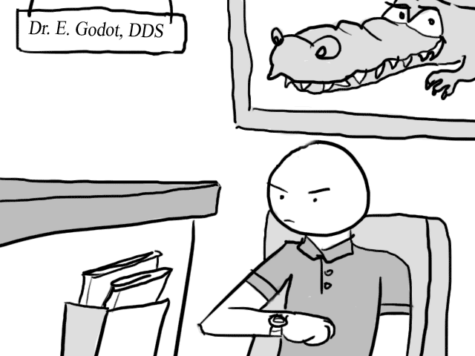
The Problem
We have short bursts of downtime everyday that may be wasted
Can we salvage this time for something that is productive, painless, interesting, and fun?
Learn about: Samurais? Renaissance Fashion? The Hindenburg? Escargot?

Slide 3
Contextual Inquiry Procedure
Wanted a group of diverse participants
Asked them to show and describe tasks they occupy themselves with when they have short amounts of free time (e.g. waiting in line)
Applied Master-Apprentice method
Asked about improvements they would like to see in current apps (content & interface)

Slide 4
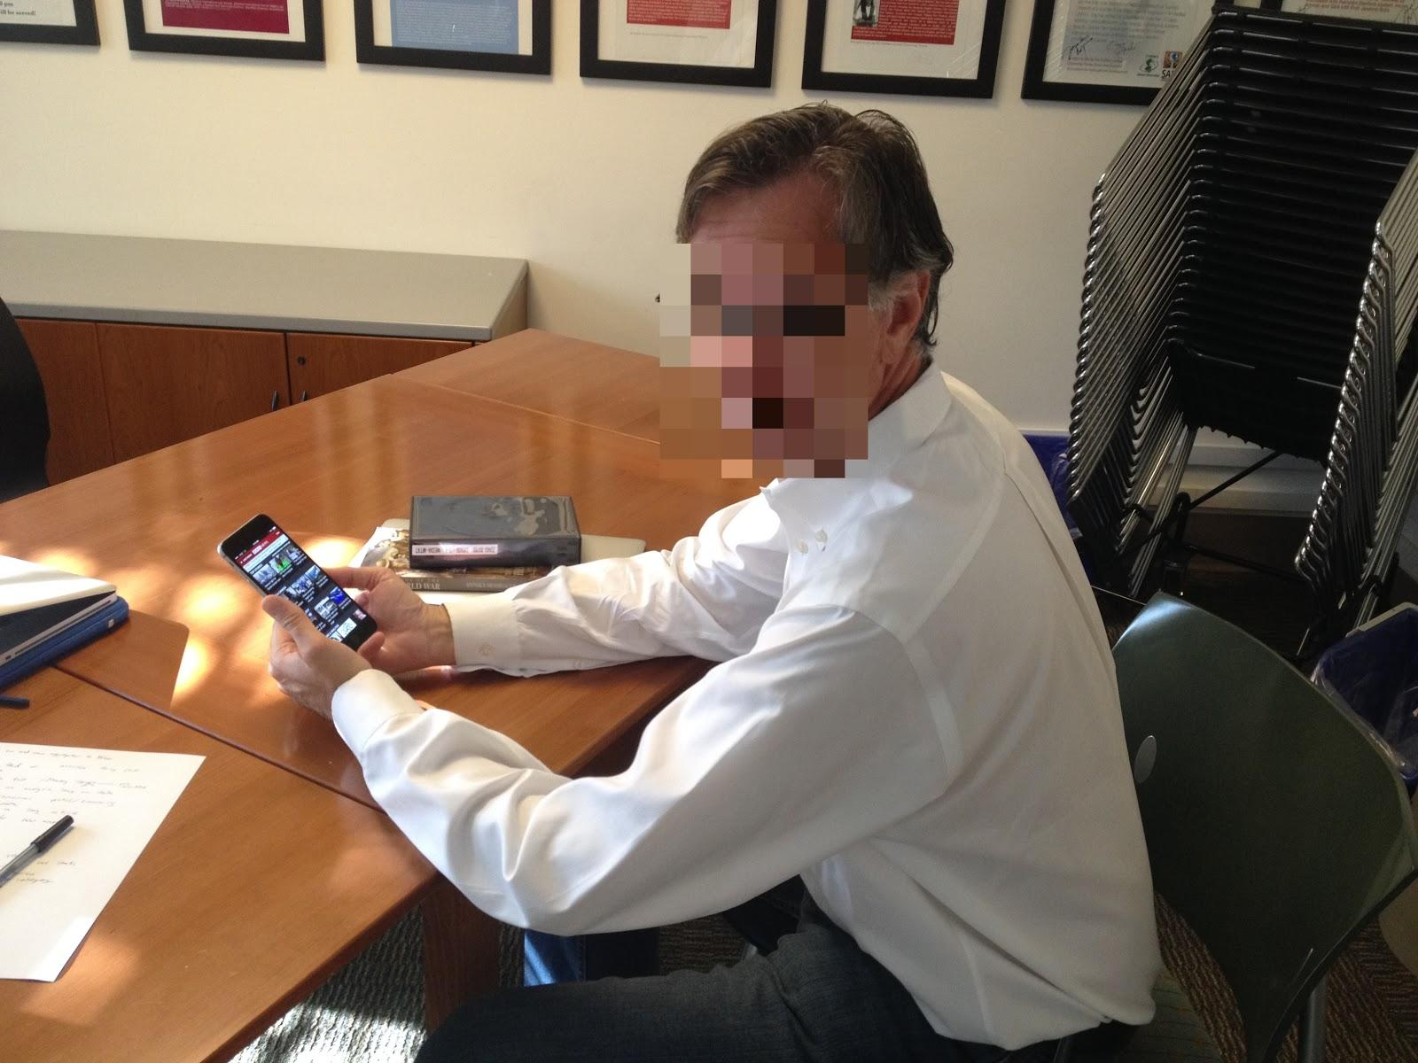
Contextual Inquiry - S.S.
Political Science professor
Chosen due to his need use all time efficiently and productively due to job
Kat recruited S.S. and interviewed him in an office
Scans for emails, checks news on 4 different news sites
Looks out for hot topics

Slide 5
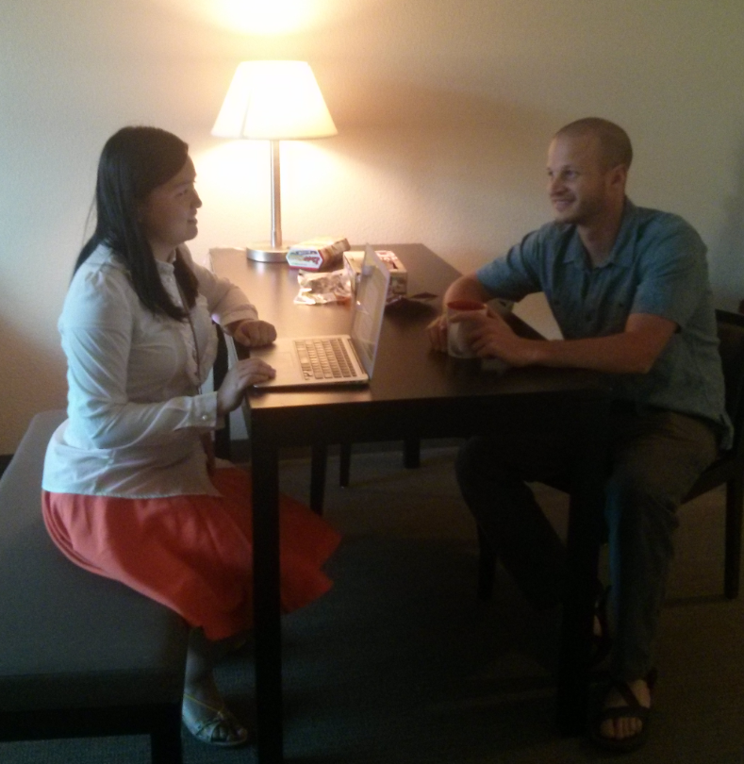
Contextual Inquiry - O.K.
Grad student in mid 20s, ex-Hedge Fund employee
Chosen for knowledge of tech industry and general interest in mobile applications
Recruited by Gabe and was interviewed in dorm
Follows blogs on technology news using blog aggregator app NewsBlur
Will browse blogs until time runs out or when content no longer seems interesting

Slide 6
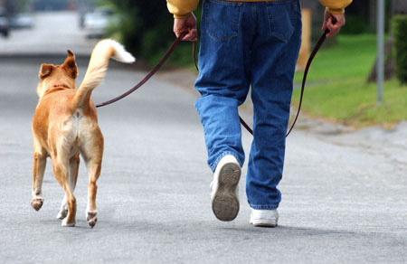
Contextual Inquiry - S.
Backend software engineer in early 30s
Chosen for job in tech industry
Leigh recruited and interviewed her on the plane
Spare time when walking dog, waiting in lines, or walking to car
Chats on Whatsapp, scan the news, or window shopping online
Checks news because likes learning new information

Slide 7
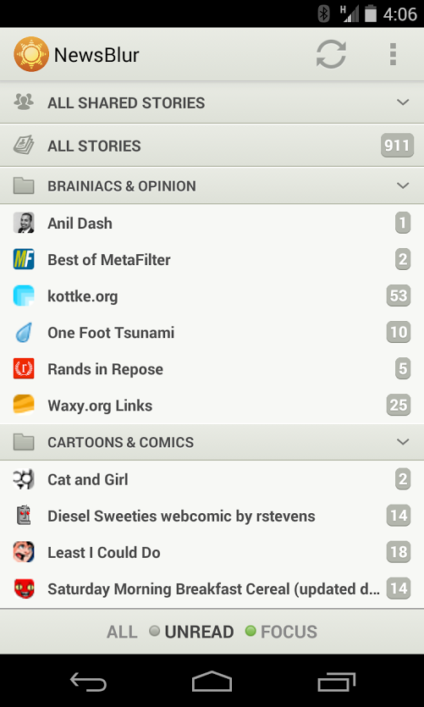
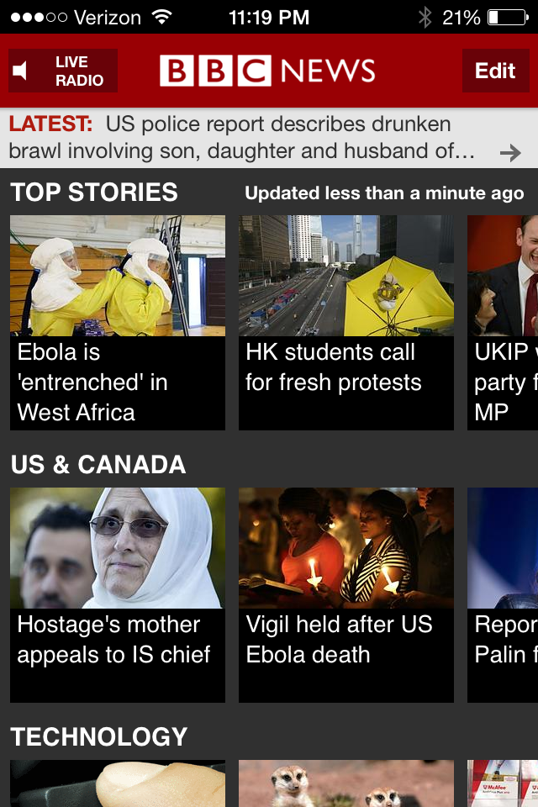
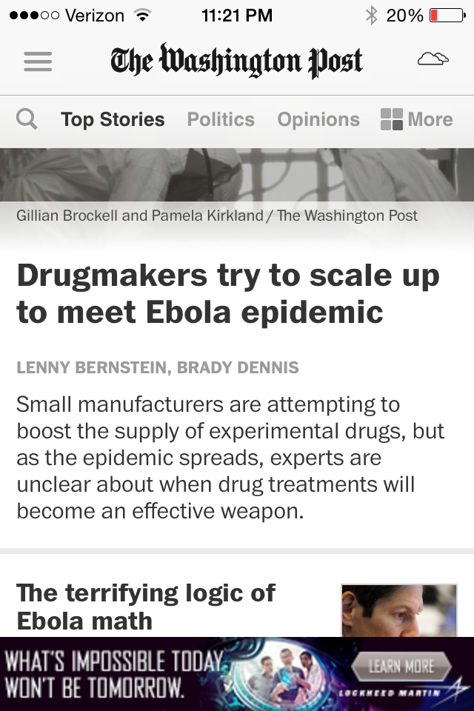
Contextual Inquiry Results
People like browsing the news
Simplicity in content and interface
Direct, private communication
History or saving not fully utilized
Look at related information

Slide 8


Task Analysis Results
Who is going to use the system?
Smartphone users who go everywhere with their phones
What tasks do they now perform?
Browse information, typically news
Communicate with others on the smartphone
What tasks are desired?
They like what they do
How are the tasks learned?
Translation from non-phone function

Slide 9
Task Analysis Results
Where are the tasks performed?
Everywhere
What’s the relationship between customer and data?
Customer wants to browse content, which they typically do not generate
What other tools does the customer have?
Many other apps, but not much outside the phone if s/he was not prepared

Slide 10
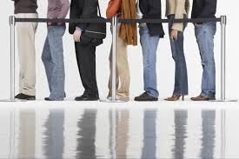
Task Analysis Results
How do users communicate with each other
Usually an individual activity, but sometimes email or instant messaging
How often are the tasks performed
2 to 3 times a day
What are the time constraints on the tasks
Usually expect less than 10 minutes
What happens when things go wrong
Think about things or wait it out

Slide 11


Representative Tasks
Browse information, mainly news
Search for information (news or existing knowledge) relating or relevant to news
Save interesting articles or viewed pages

Slide 12
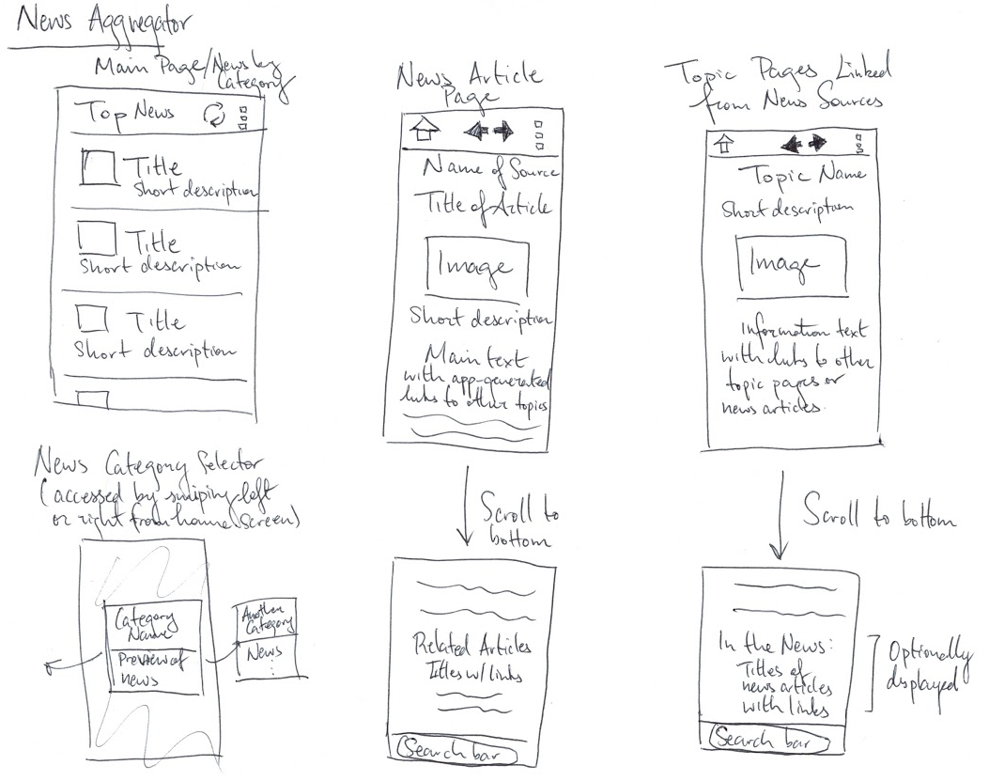
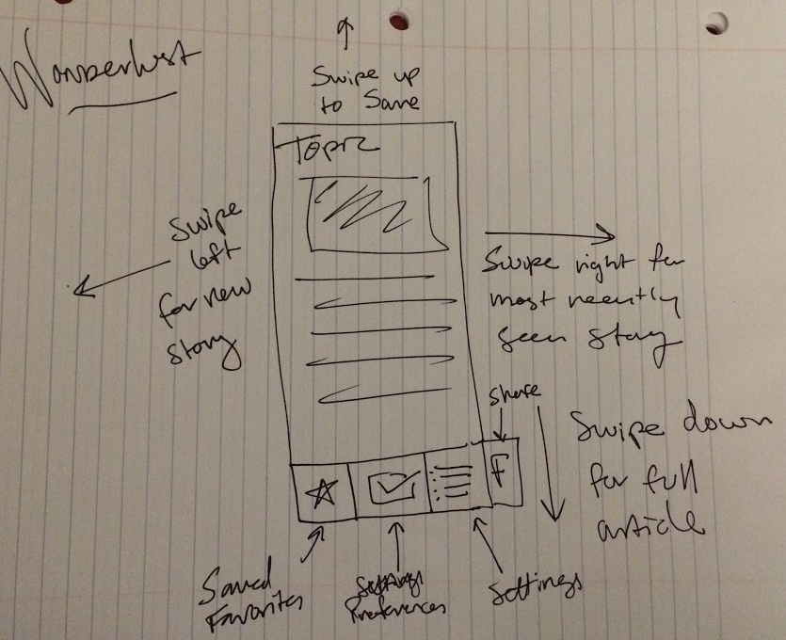
Application Ideas
Full Page Items

Slide 13
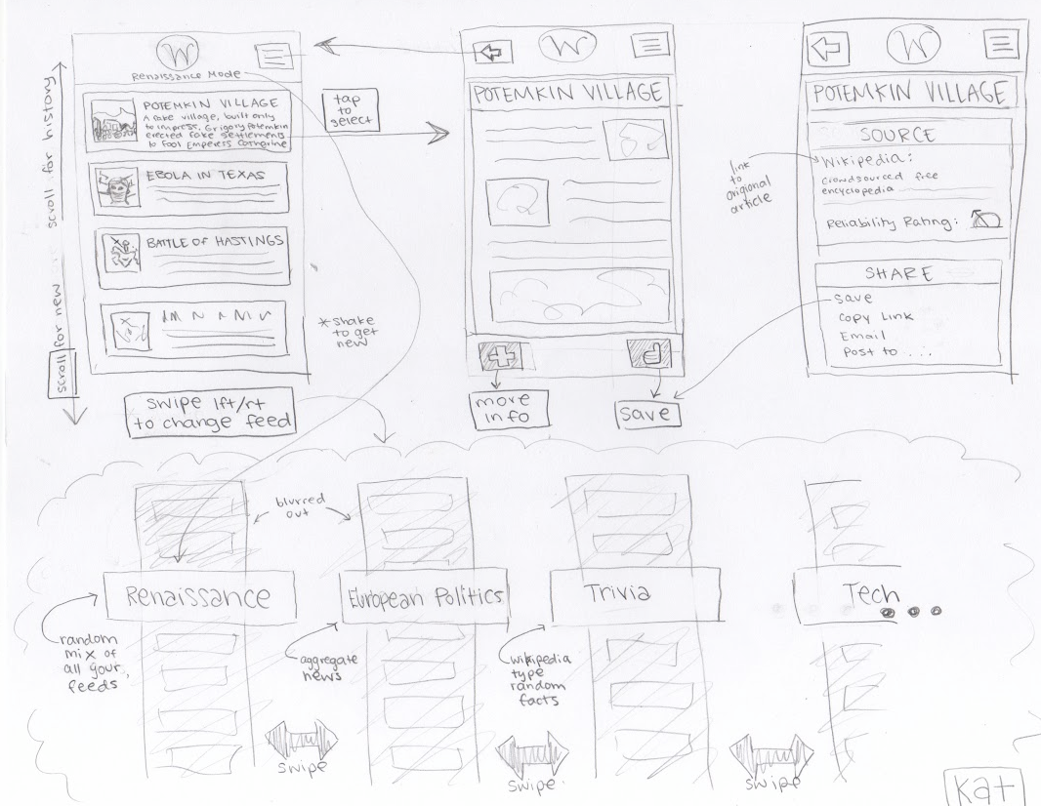
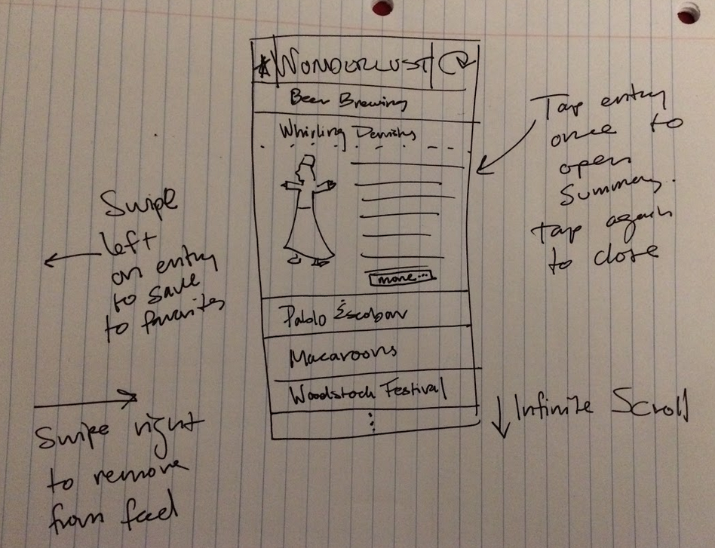
Application Ideas
Expanding Bar Entries

Slide 14
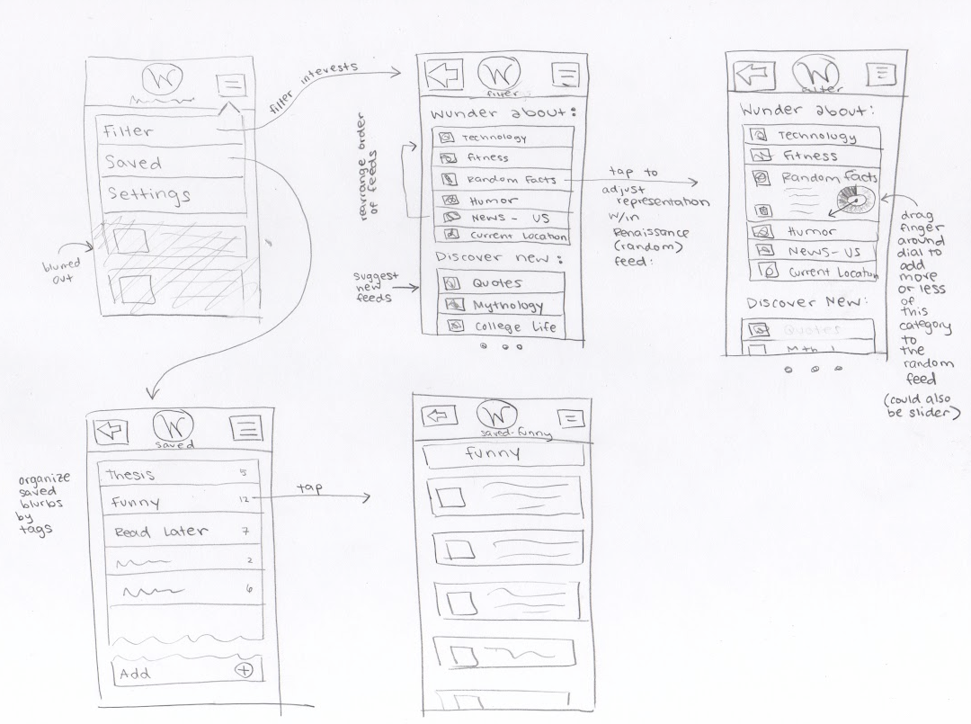
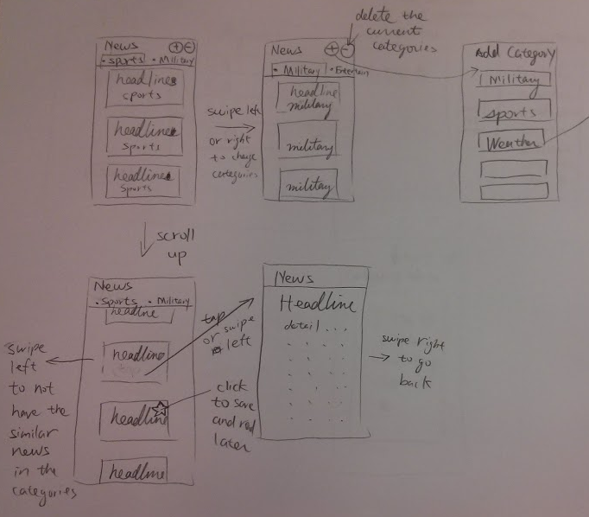
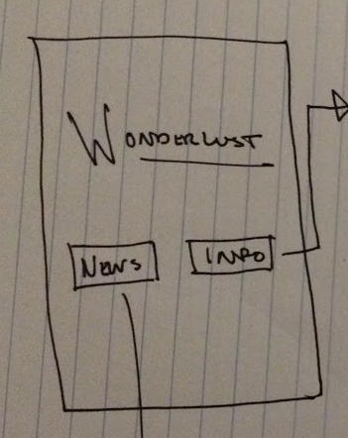
Application Ideas
Category-Centric

Slide 15
Summary
People generally like to browse different things when they are trying to kill time
Develop an app to engage users to become more knowledgeable about the content they are browsing

Slide 16
Questions?

